Slide 1
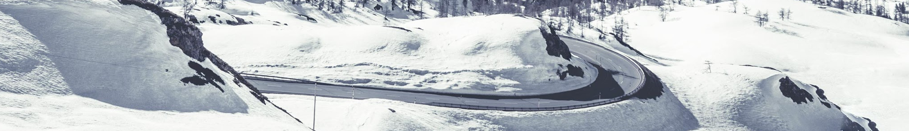
Forecasting of Bookings

Slide 2
Problems to solve
Predicting the number of bookings of a specific hotel on a particular date.
Accounting the yearly change in trends in bookings.
1
3
2
Accounting for the seasonal changes and trends in the bookings.
4
Normalizing the stay days before and after the peak booking dates.

Slide 3
Prediction for One Hotel
Training the model on the particular hotels data only, as the trend of booking number changes would remain similar. The variations would be in the actual amount.

Slide 4
Yearly change in trends
This is accounted by by taking the ratio of bookings of the previous two years. This factor is used on the predicted number of bookings to give a closer prediction, accounting the change in trend.

Slide 5
Normalizing the booking number around the peak dates.
Increase in bookings due to some events will affect the days before and after it.
The predicted bookings are averaged around the day before and after it, to normalize the peak bookings.

Slide 6
Machine Learning Models Used
Polynomial Regression
LSTM - Keras, TensorFlow

Slide 7
Polynomial Regression
Prediction of bookings up to any number of days is possible.
RMSE ~ 10, was observed using the “Casino Hotel” Bookings data.

Slide 8
Features Used in Polynomial Regression Model
Month as a feature
Day of the week
Weekend or not
Friday , Saturday and Sunday are weekends

Slide 9
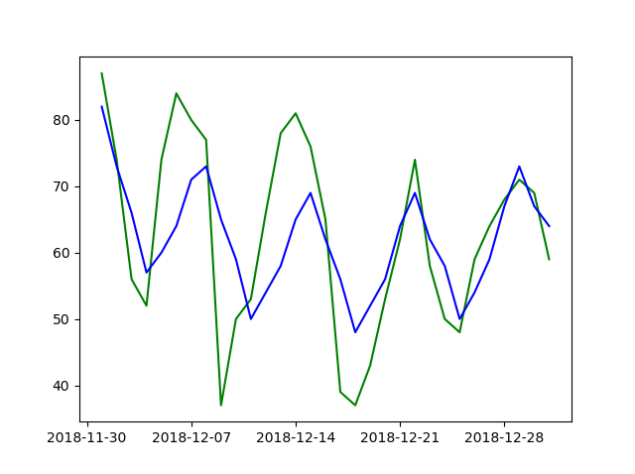
Polynomial Regression – Casino Hotel prediction for Dec’18
Green – Actual no. of Bookings
Blue - Prediction

Slide 10
LSTM - Long Short Term Memory
Prediction of next days bookings, factoring the previous days bookings.
RMSE ~ 9, using very less features
Further not implemented because of high training time and short duration forecasting possible.
01
03

Slide 11
Findings
With Polynomial Regression model , RMSE of around 10 is possible if booking data is present for previous two years.
With LSTM , RMSE ~ 9 is possible for predicting next day’s bookings .
Polynomial Regression is more suitable as it can forecast 30 days bookings with good accuracy.

Slide 12
Applications and Uses
Monthly booking predictions can be used to set monthly revenue targets.
With weekly booking forecast, it’ll be possible to adjust booking rates to achieve the target revenue.
Daily forecasts can be used to set rates to achieve daily targets.

Slide 13
Thank you.

